Slide 1
SOA Platform technologies
Alan Mateus amvn@cin.ufpe.br
Danilo Vieira dvl@cin.ufpe.br

Slide 2
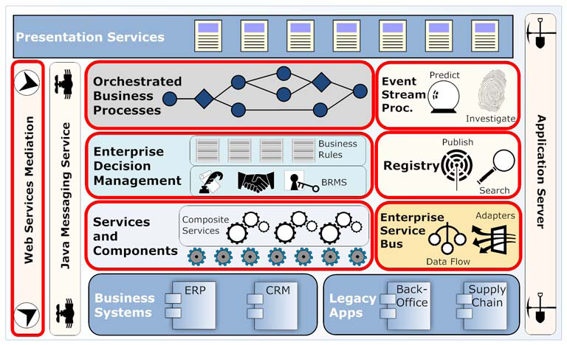
SOA Platform technologies.

Slide 3
History and Principles
Service-oriented architecture (SOA) has emerged over the past several years as one of the preferred approaches for systems design, development, and integration.

Slide 4
History and Principles
SOA is premised on the notion of reusable services that correspond to self-contained, logical units of work.

Slide 5
History and Principles
The promise is that these services can be quickly pieced together using common patterns to form new applications that are tightly aligned with the needs of the business. The upshot?
  Improved business agility and cost-effective of IT resources and assets.

Slide 6
History and Principles
Service-Oriented Architecture is an IT strategy that organizes the discrete functions contained in enterprise applications into interoperable, standards-based services that can be combined and reused quickly to meet business needs. [BEA]

Slide 7
Characteristics of SOA
Service interface/contract
  Services must have a well-defined interface or contract. A contract is the complete specification of a service between a service provider and a specific consumer.
  Ex: Service Calc

Slide 8
Characteristics of SOA
Service transparency
  The ability to call a service without specific awareness of its physical endpoint within the network.

Slide 9
Characteristics of SOA
Service loose coupling
  The service is sufficiently self-contained so that it could be considered stand alone.

Slide 10
Characteristics of SOA
Service composition
  Defining a data flow that stitches together services and then exposes the new functionality as new service.

Slide 11
Characteristics of SOA
Service registry and publication
  A client could theoretically, at least, “discover” services and bind to them.

Slide 12
History and Principles
Contemporary SOA represents an open, agile extensible, federated, composable architecture comprised of autonomous, QoS-capable, vendor diverse, interoperable, discoverable, and potentially reusable services, implemented as Web services. [Erl2005]

Slide 13
The promise of web services for delivering SOA
XML based standards
  Simple Object Access Protocol (SOAP)
  Web Services Description Language (WSDL )
  Universal Description, Discovery, and Integration (UDDI).

Slide 14
Another way to offer service
Representational State Transfer (REST)
  Accessed with request HTTP;
  Web Application Description Language (WADL )
  Using the HTTP methods(GET,POST,PUT,DELETE)
  Using the URI(e.g. http://example.com/resource)

Slide 15
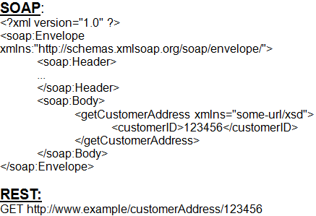
SOAP x REST

Slide 16
SOA Platform technologies.

Slide 17

Assembling components and services

Slide 18
Assembling components and services
Services are core to SOA.
They represent functional, reusable units of code that can be combined to form applications or business processes.

Slide 19
Assembling components and services
Component
  Software element that encapsulates a series of functionalities.
These components can be wired together internally to form higher-level services, or composites.

Slide 20
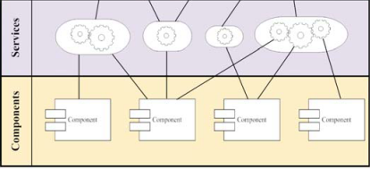
Assembling components and services

Slide 21
SOA Platform technologies.

Slide 22

Business process management (BPM)

Slide 23
Business process management (BPM)
“Processes are the business” [Fingar]
BPM represents a new paradigm for software application development where services can be woven together into visual models that reflect actual business processes.

Slide 24
Business process management (BPM)
BPM, on the other hand, is intended to encompass the entire value chain process, including interactions with external partners or customers.

Slide 25
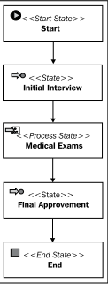
Business process management

Slide 26
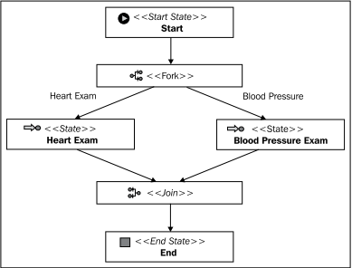
Business process management

Slide 27
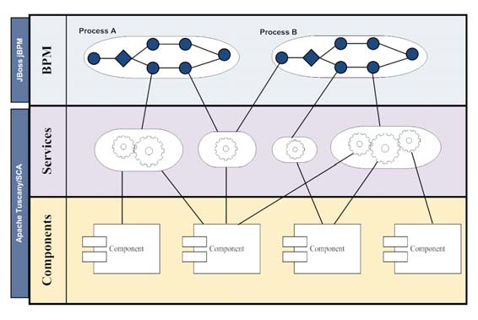
Business process management

Slide 28
SOA Platform technologies.

Slide 29

Enterprise Decision Management

Slide 30
Enterprise Decision Management
Is a systematic approach to automating and improving operational business decisions.
It aims to increase the precision, consistency and agility of these decisions and reduce the time to decide and the cost of the decision.

Slide 31
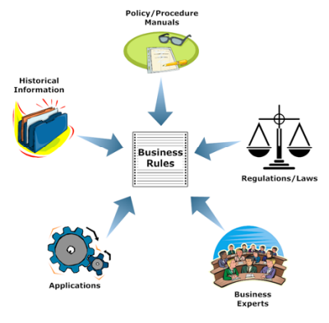
Rules Based Systems
  Business rules:
    It is a statement, written in a manner easily digestible by those within the business, which makes an assertion about some aspect of how the business should function.

Slide 32
Rules Based Systems - Benefits
Reduction in development costs;
Rule Longevity and sharing
Performance
Reduction in maintenance costs;

Slide 33
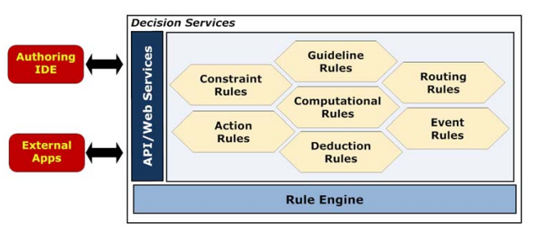
Rules Based Systems
rule "CostumerOrder“
when
person : Person( type =”Premium”);
then
System.out.println(“free shipping”);
end

Slide 34
SOA Platform technologies.

Slide 35

Event stream processing

Slide 36
Event stream processing
Used to detect any unusual patterns of activity and provide real-time notification to the appropriate business users.

Slide 37
Event stream processing
ESP is an emerging technology for finding relationships between series of simple and independent events from different sources, using previously defined rules.

Slide 38
Event stream processing,
What is an event?
  an event is really just a fact of something occurring
Event object
Event processor
Event Stream

Slide 39
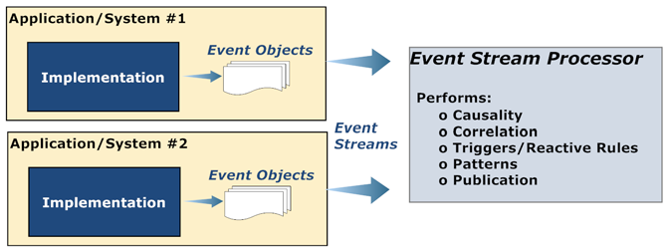
Event stream processing,

Slide 40
Event stream processing,
Definition rules:
  set to specify the lowest acceptable stock of product that the store can have to avoid a shortage, e.g., a 10% for normal products and a 5% for some low-demand products.
  Whenever a product reaches a minimum, the ESP alerts the managers so they can make a supply order.

Slide 41
Event stream processing
ESP rules to analyze the frequency of sells of each product during the last 4 or 5 hours.

Slide 42
SOA Platform technologies.

Slide 43

Enterprise Service Bus (ESB)

Slide 44
Enterprise Service Bus (ESB)
An enterprise service bus (ESB) is at its core a “middleware”.
  Reliability features ensure that delivery of messages is guaranteed and arrives at its destination with integrity (that is, it was received in the same form it was sent).

Slide 45
Enterprise Service Bus (ESB)
Core capabilities
  Xml-based messaging
  Intelligent routing and distribution
  Monitoring and administration

Slide 46
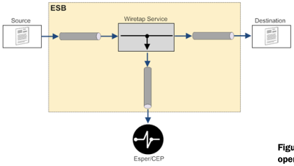
Enterprise Service Bus (ESB)
  Xml-based messaging
    Interrogating the content of XML messages for any variety of operations, including routing, aggregation, enrichment, and validation.

Slide 47
Enterprise Service Bus (ESB)
  Intelligent routing and distribution
    Processing pipeline
    Routing slip
    Centralized router
    Content-based routing
    Component based routing

Slide 48
Enterprise Service Bus (ESB)
  Monitoring and administration
    Messages received
    Number of faults
    Average processing time
    Number of messages processed per transport
    Queue size
    Messages processed per endpoint or proxy

Slide 49
SOA Platform technologies.

Slide 50

Web Services Mediation

Slide 51
Web Services Mediation
Refers to brdging between different communications protocols, with the result being a SOAP-based web service that can be redirected to na appropriate endpoint.
  Example:
    REST – SOAP
    FTP - SOAP

Slide 52
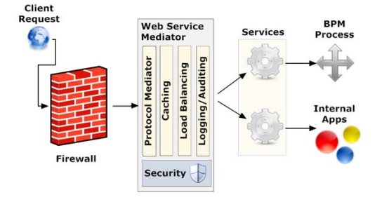
Web Service Mediation - Features
    Runtime Governance
    Version Rationalization
    Traffic Manager
    Protocol Mediation

Slide 53
SOA Platform technologies.

Slide 54

Registry

Slide 55
Registry
A client could theoretically, at least, “discover” services and bind to them

Slide 56
Registry
The implementation artifacts that derive from a SOA should be registered within a repository to maximize reuse and provide for management of enterprise assets.

Slide 57
Registry
Assets
  Service components and composites
  Business process / orchestrations
  Applications

Slide 58
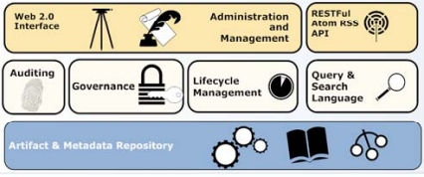
Registry

Slide 59
SOA Platform technologies.

