Slide 1

Assessment to support the planning of sustainable data centers with high availability
Gustavo Rau de Almeida Callou
grac@cin.ufpe.br
Supervisor: Prof. Paulo Romero Martins Maciel
prmm@cin.ufpe.br

Slide 2
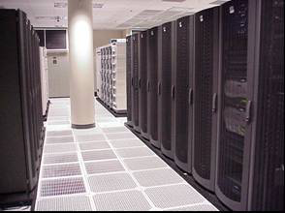
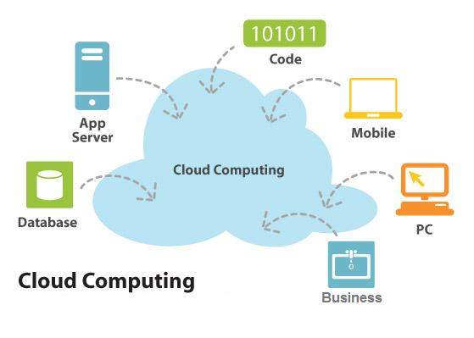
Introduction
  Data centers are growing
  Fact (Considering U.S.)
    Data centers consume about 2 %
    of the whole power generated .
  Concern about
    Energy Consumption,
    Environmental Sustainability.
  Sustainable data centers
    Least amount of materials,
    Least energy consumption.
  Availability
  Fault-Tolerance

Slide 3
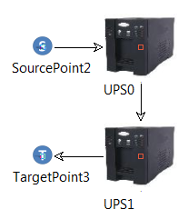
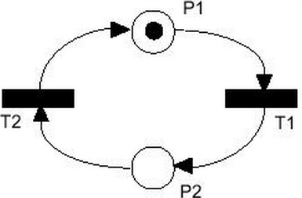
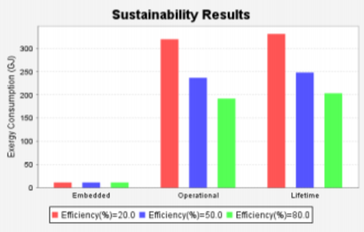
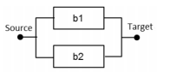
Objective
To provide:
  Assessment to support the planning of data center power and cooling infrastructures regarding sustainability impact, dependability metrics and cost issues.
  High-level models → SPN or RBD → availability,
  sustainability impact, etc

Slide 4
Objective
More specifically, the objectives are:
  To propose a set of formal models for estimating sustainability impact, total cost of ownership and dependability metrics of power and cooling data center infrastructures.
  To construct models that represent data center power and cooling infrastructures
  To perform the evaluation of those models in order to compare the results as well as to identify system parts that may be improved.
  To propose data center architectures

Slide 5
Objective
More specifically, the objectives are:
  To consider a methodology that allows data center designers to analyze the system piecewise as well as to combine the evaluation results
  To develop a tool that implements the above models and enables a data center designer/administrator to estimate those metrics without the knowledge of formal models.
  To consider other sustainability impacts besides exergy (e.g., PUE)
Notes:
To study hardened computing and its associated metrics (e.g., Thermal, Contamination, Humid, Power dissipation, System architecture);

Slide 6
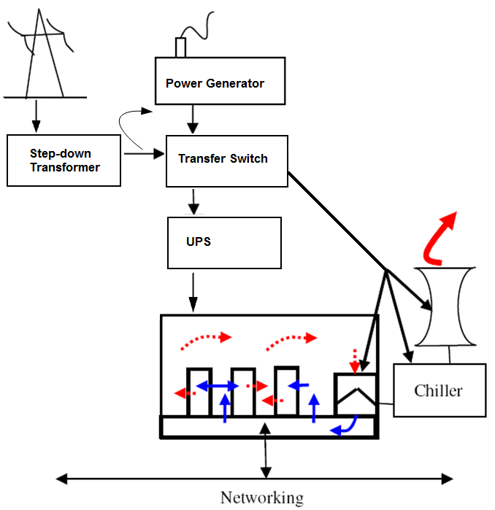
Data Center Infrastructure
  IT infrastructure:
    Servers,
    Networking equipment,
    Storage devices.
  Power infrastructure:
    SDT → transfer switches → UPS → PDUs → rack
  Cooling infrastructure:
    Extracts heat → prevents overheating
    CRAC, Cooling Tower, Chiller

Slide 7
Data Center Infrastructure
  IT infrastructure:
    Servers,
    Networking equipment,
    Storage devices.
  Power infrastructure:
    SDT → transfer switches → UPS → PDUs → rack
  Cooling infrastructure:
    Extracts heat → prevents overheating
    CRAC, Cooling Tower, Chiller

Slide 8
    Sustainability Metrics
  Exergy (available energy)
    We choose quantify the environmental impact in terms of exergy.
    Represents the maximal theoretical portion of the energy that could be converted into work;
    A system which consumes the least amount of exergy is often the most sustainable;
The total exergy destroyed across a product’s lifetime (“lifetime exergy consumption”).

Slide 9
Sustainability Metrics
The following phases are considered in our evaluation:
    Embedded phase - Involves impacts related to product design decisions (material extraction, manufacturing and recycle).
    Operational phase – Involves impacts related to decisions during product use (operational and maintenance).

Slide 10
Component Importance
A metric that indicates the impact of a particular component in the system's reliability.
Various measures are available for estimating component importance, we adopted reliability importance.

Slide 11



Reliability Importance
The RI of component i can be estimated as:
= 1₁ * p₂ * p₃ – 0₁ * p₂ * p₃
= 1 * 0.6 * 0.65
= 0.39

Slide 12
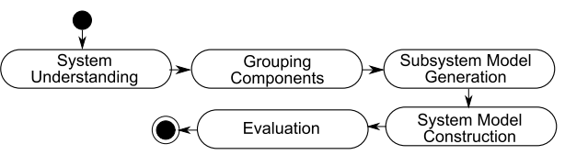
Methodology

Slide 13
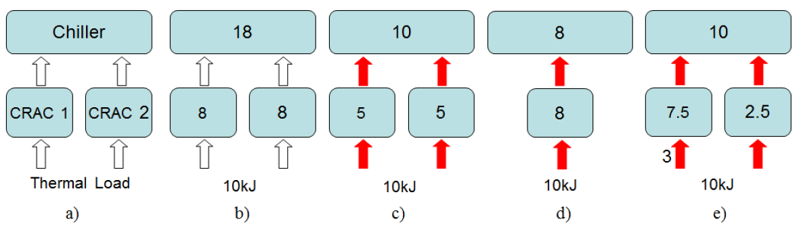
Models
Energetic Model
  The system under evaluation can be correctly arranged, but they may not be able to meet system demand for electrical energy or thermal load.

Slide 14
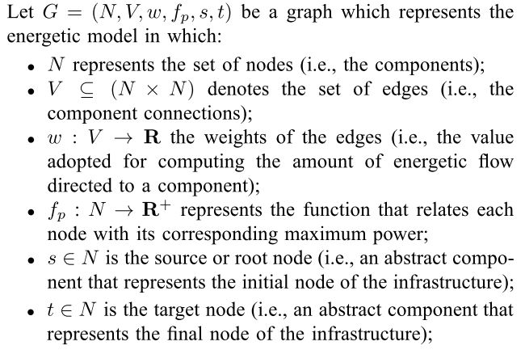
Models
Energetic Model Definition

Slide 15
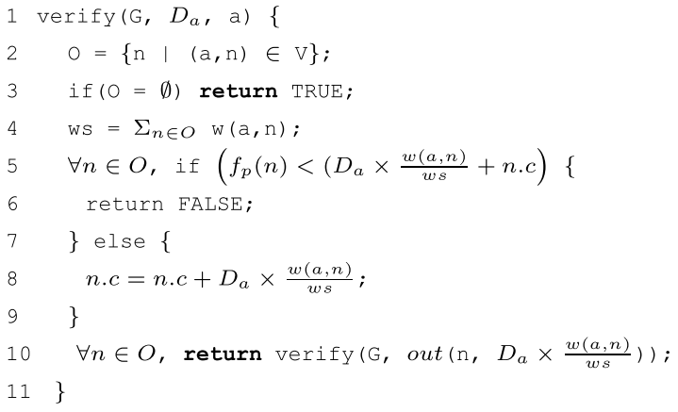
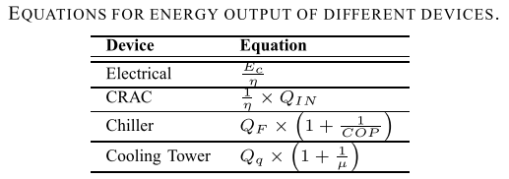
Models
Energetic Algorithm

Slide 16
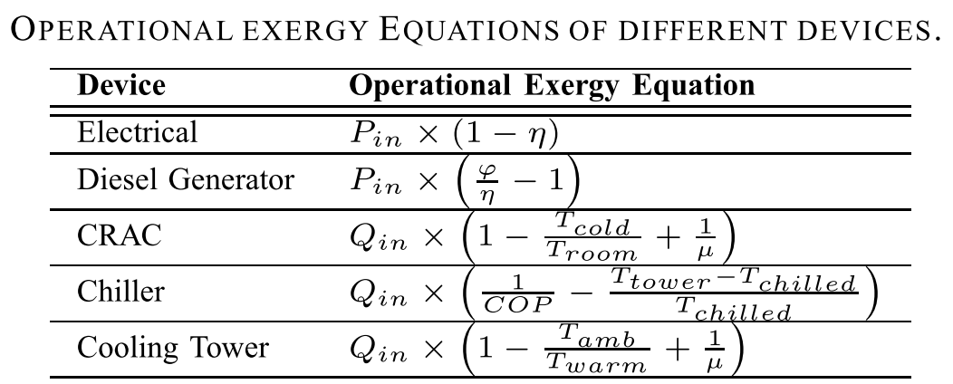
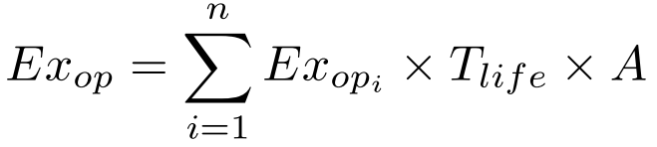
Models
Sustainability Model
  Metrics
    Embedded Exergy
    Operational Exergy:

Slide 17
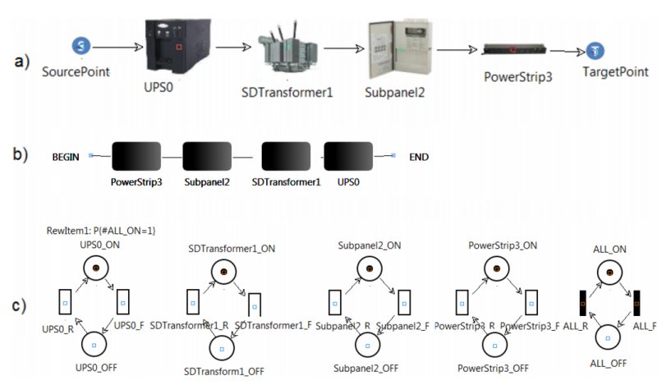
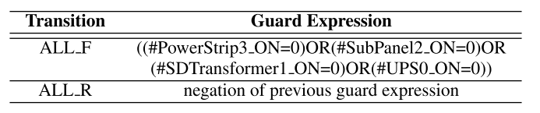
Models
Dependability Models
  RBD
  SPN

Slide 18
Case Study
From a baseline data center power infrastructures, we propose 6 architectures.
Reliability Importance.
For each architecture, we estimate:
  (i) availability;
  (ii) the sustainability impact and
  (iii) the total cost ownership.

Slide 19
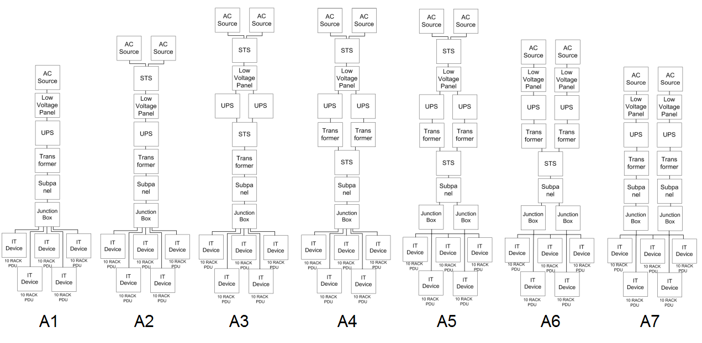
Power Architectures

Slide 20
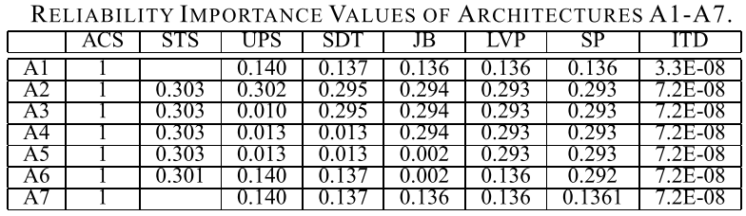
Power Architectures

Slide 21
Power Architectures

Slide 22
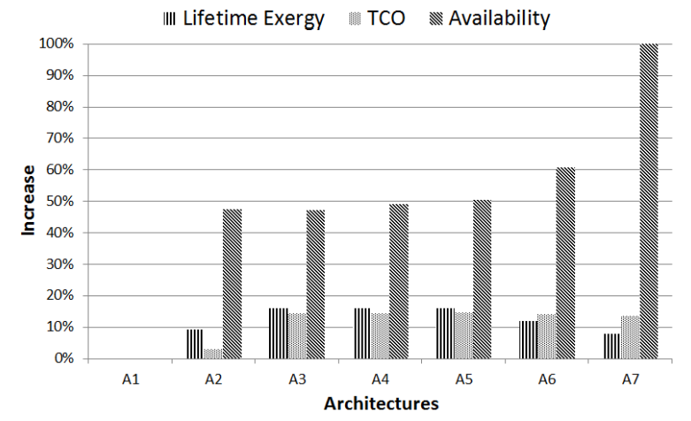
Case Study
Results

Slide 23
Conclusion
Presented:
  a set of formal models to estimate the availability, TCO and sustainability impacts of data center infrastructures.
  A methodology that considers the advantages of both SPN and RBD formalisms;
  reliability importance index to propose architectures with higher availability.
  Experiments demonstrated the applicability of the proposed approach.
As a future work, we intend to analyze other scenarios.

Slide 24
Thanks!

