Slide 1
Assessment to support the planning of sustainable data centers with high availability
^{Gustavo Rau de Almeida Callou}
^{grac@cin.ufpe.br}
Adviser: Professor Paulo Romero Martins Maciel
prmm@cin.ufpe.br

Slide 2
Agenda
Introduction
Objective
Preliminaries
Data Center Infrastructure
Metrics
Exergy
Stochastic Petri Nets
Reliability Block Diagrams
Optimization
Models
ASTRO/Mercury Environment
Case Study

Slide 3
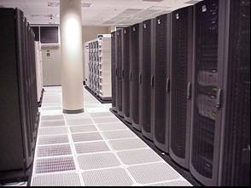
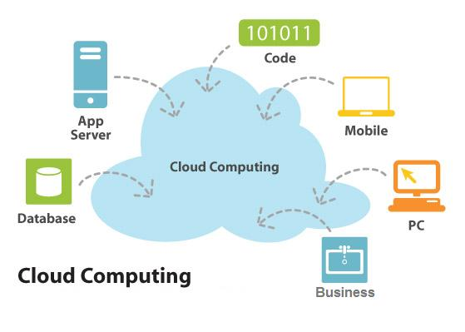
Introduction
Data centers are growing
Fact (Considering U.S.)
Data centers consume about 2 %
of the whole power generated .
Concern about
Energy Consumption,
Environmental Sustainability.
Sustainable data centers
Least amount of materials,
Least energy consumption.
Availability
Fault-Tolerance

Slide 4
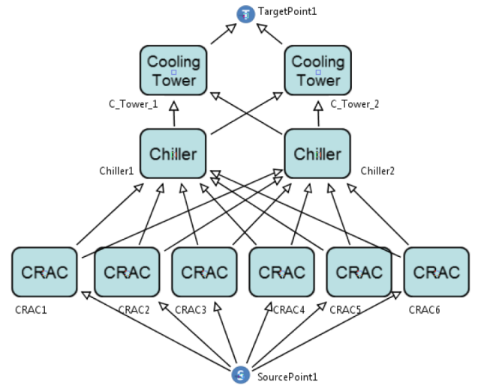
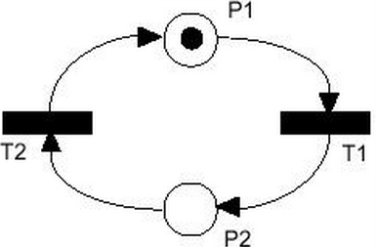
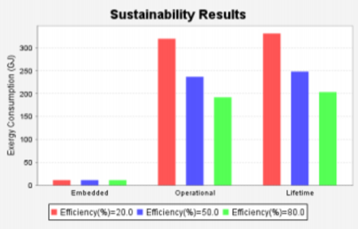
Objective
To provide:
a set of models for the integrated quantification of sustainability impact, cost and dependability of data center power and cooling infrastructures.
Energy Flow Model, SPN and RBD → availability, downtime, cost
sustainability impact, etc

Slide 5
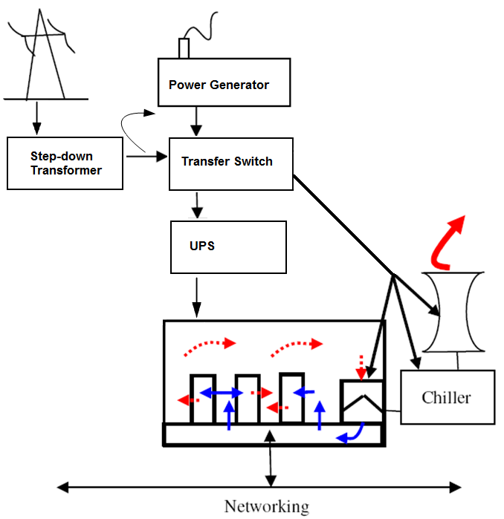
Data Center Infrastructure
IT infrastructure:
Servers,
Networking equipment,
Storage devices.
Power infrastructure:
SDT → transfer switches → UPS → PDUs → rack
Cooling infrastructure:
Extracts heat → prevents overheating
CRAC, Cooling Tower, Chiller

Slide 6
Metrics
Dependability
Availability
Reliability
Reliability Importance (RI)
Reliability and Cost Importance (RCI)
Sustainability Impact
Exergy Consumption
CO2 Emissions
Cost
Acquisition cost
Operational cost

Slide 7
Exergy
Energy can never be destroyed (FLT).
Exergy can be destroyed (SLT).
The exergy destruction or consumption (irreversibility) must be appropriately minimized to obtain sustainable development.
Exergy (available energy)
Represents the maximal theoretical portion of the energy that could be converted into work;
A system which consumes the least amount of exergy is often the most sustainable;
Exergy is useful when measuring the efficiency of an energy conversion process
Notes:
Dizer o que é exergy
Comparar e mencionar pq é melhor quantificar exergy do q energy consumption
Falar q como é computado, vai ser mostrado mais adiante.

Slide 8
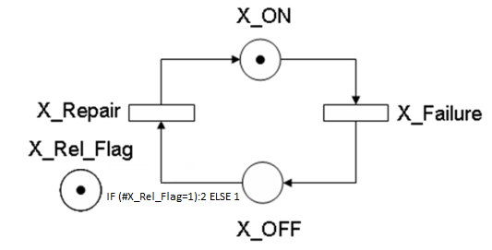
Stochastic Petri Net (SPN)
Simple Component
A_R = P{#X_ON>0}

Slide 9
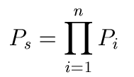
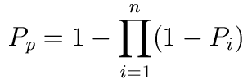
Reliability Block Diagrams (RBD)
A Reliability Block Diagram (RBD) is a non-state space model that enables analysis of reliability and availability of complex systems using block diagrams.
In a block diagram model, components are combined into blocks in series, parallel, or k-out-of-n.
The structure of RBD establishes the logical interaction among components

Slide 10
Optimization
Many problems can be modeled as an optimization problem that seeks to maximize or minimize the objective function.
This function maybe composed of a single or multi variables depending on the optimization problem.

Slide 11
Optimization
Greedy Randomized Adaptive Search Procedure (GRASP) is adopted to optimize:
dependability,
sustainability and
cost issues.
Those values are estimated through the EFM and dependability models.

Slide 12
Optimization
The GRASP algorithm → two phases:
Construction,
Local search.
Construction → builds a feasible solution.
Local search → investigates the neighborhood to improve the solution in each iteration of the algorithm
The best solution overall GRASP iterations is returned as the result.

Slide 13
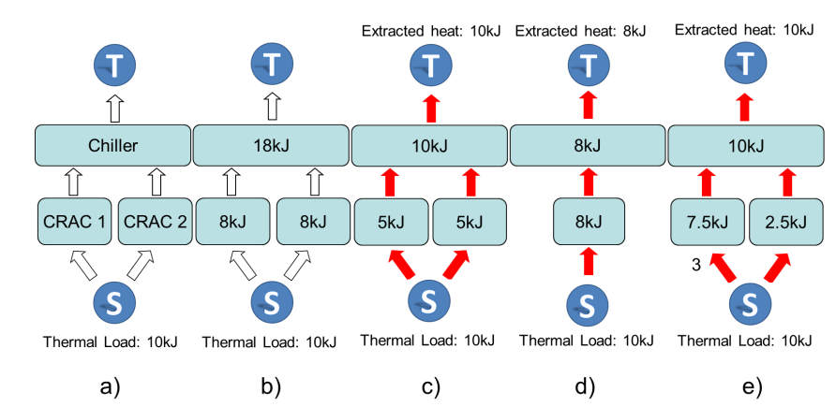
Energy Flow Model
The system under evaluation can be correctly arranged, but they may not be able to meet system demand for electrical energy or thermal load.

Slide 14
Energy Flow Model
Algorithms:
Verifying the energy flow
Quantifying Operational Exergy Consumption
Quantifying acquisition and operational costs

Slide 15
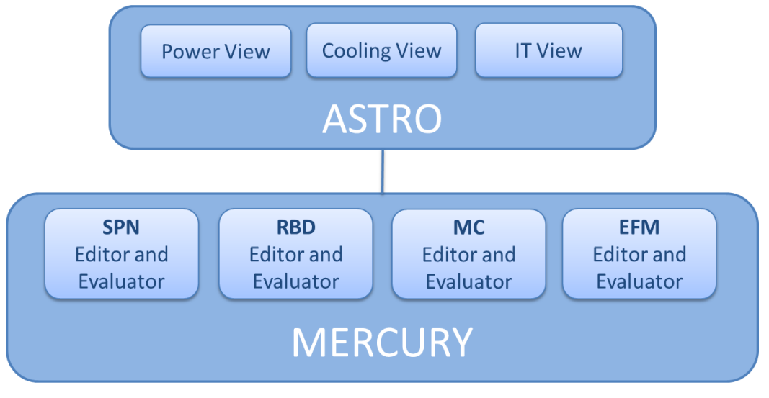
ASTRO Environment

Slide 16
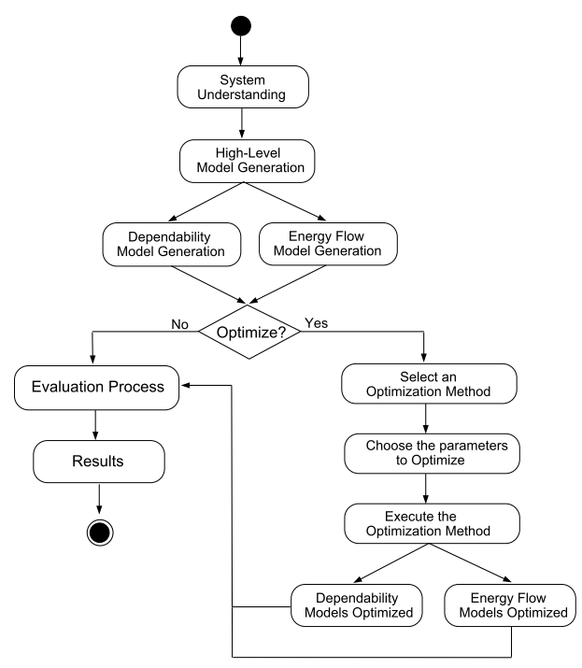
Methodology

Slide 17
Case Study
To illustrate the applicability of the adopted methodology that makes use of a GRASP-based method to optimize:
Cost
Availability
Sustainability

Slide 18
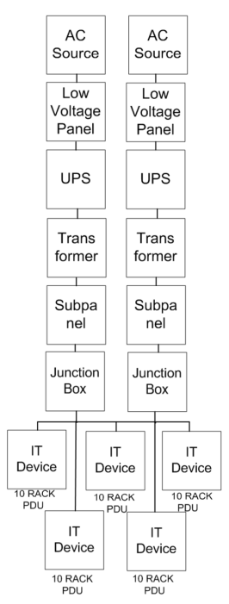
Architecture

Slide 19
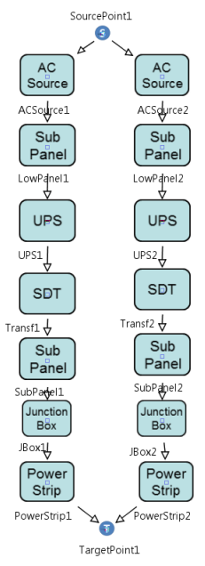
RBD and EFM Models

Slide 20
Results

Slide 21
Final Remarks
Data center designers do not have many mechanisms to support the integrated sustainability, cost and dependability evaluation of data center infrastructures.
This work aims at reducing this gap by proposing models (supported by the developed environment ASTRO/Mercury)
As a future work, we intend to analyze other scenarios.

Slide 22
Published Papers
[1] M. Marwah, P. Maciel, A. Shah, R. Sharma, G. Callou. Quantifying the sustainability impact of data center availability. SIGMETRICS. Perform. Eval. Rev., 37:64–68, March 2010.
[2]:G. Callou, P. Maciel, F. Magnani, J. Figueiredo. Estimating sustainability impact, total cost of ownership and dependability metrics on data center infrastructures. In Proceedings of the IEEE International Symposium on Sustainable Systems and Technology (ISSST), pages 1-6, Chicago, USA, 2011. (IEEE Student Paper Competition – FIRST PLACE)
[3]: G. Callou, P. Maciel, F. Magnani, E. Tavares. Sustainability and dependability evaluation on data center architectures. In Proceedings of the IEEE International Conference on Systems, Man, and Cybernetics, pages 1-6, Anchorage, Alaska, USA, 2011.
[4]: G. Callou, E. Sousa, P. Maciel, E. Tavares. A formal approach to the quantification of sustainability and dependability metrics on data center infrastructures. In Proceedings of the 2011 Symposium on Theory of Modeling and Simulation (TMS/DEVS), Boston, MA, USA, 2011. ACM.
[5]: Callou, G.; Maciel, P.; Tutsch, D.; Araujo, J.; , "Models for dependability and sustainability analysis of data center cooling architectures, in Proceedings of IEEE/IFIP 42nd International Conference on Dependable Systems and Networks Workshops (DSN-W), Boston, MA, USA, pp.1-6, 25-28 June 2012.
[6] Gustavo Callou, Paulo Maciel, Dietmar Tutsch, Julian Araújo, João Ferreira, Rafael Souza: A Petri Net-Based Approach to the Quantification of Data Center Dependability, in: Petri Nets - Manufacturing and Computer Science, InTech, Open Access Publisher, August 2012.

Slide 23
Thanks!
^{Gustavo Callou}
^{grac@cin.ufpe.br}

