Slide 1
Smart Offloading for Mobile Cloud Applications
Francisco Airton
PhD Student
faps@cin.ufpe.br
Orientador: Paulo Maciel
Notes:
O trabalho se encontra em fase inicial

Slide 2
Agenda
Context
Motivation
Problem
Solution
Next Steps

Slide 3
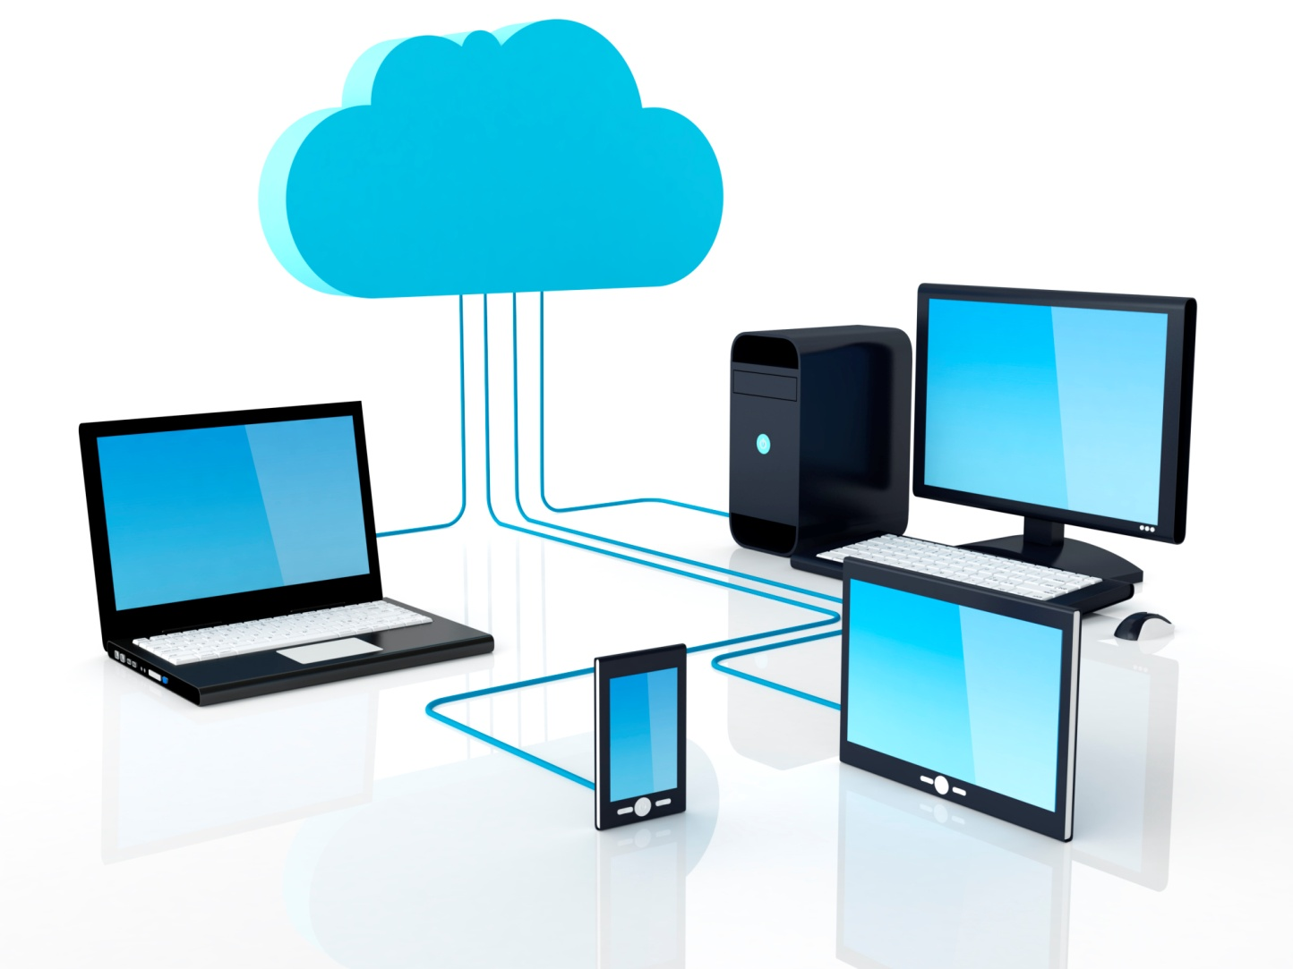
Context
Mobile Cloud Computing (MCC)
Notes:
Cloud computing (CC) has been widely recognized as the next generation’s computing infrastructure.
CC offers some advantages by allowing users to use
infrastructure (e.g., servers, networks, and storages),
platforms (e.g., middleware services and operating systems), and
softwares (e.g., application programs)
provided by cloud providers (e.g., Google, Amazon, and Salesforce) at low cost. In addition, CC enables
users to elastically utilize resources in an on-demand fashion.
As a result, mobile applications can be rapidly provisioned and released with the minimal management efforts or service provider’s interactions.
With the explosion of mobile applications and the support of CC for a variety of services for mobile
users, mobile cloud computing (MCC) is introduced as an integration of cloud computing into the mobile
environment. Mobile cloud computing brings new types of services and facilities for mobile users to take
full advantages of cloud computing.

Slide 4
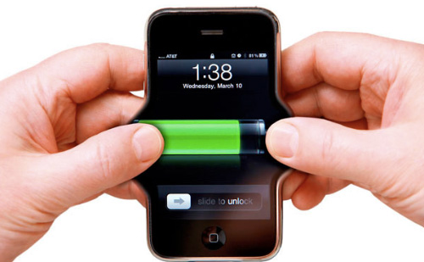
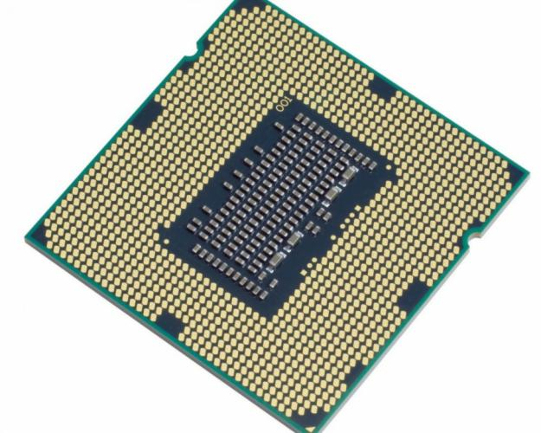
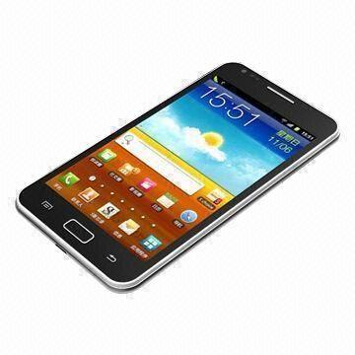
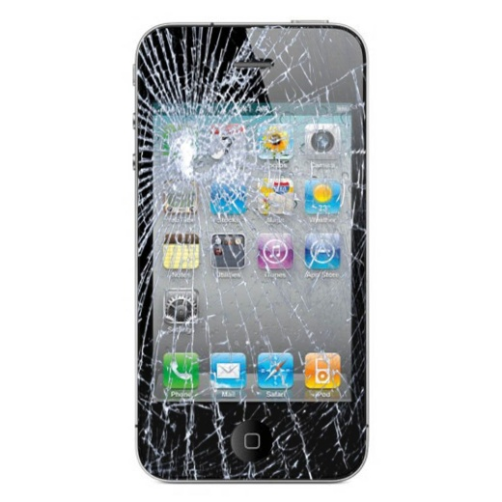

Context
(MCC Advantages)
Notes:
Extending Battery Lifetime
Improving data storage capacity and processing power
Improving reliability
Extending Battery Lifetime
Battery is one of the main concerns for mobile devices. Several solutions
have been proposed to enhance the CPU performance [14], [15] and to manage the disk and screen in
an intelligent manner [16], [17] to reduce power consumption. However, these solutions require changes
in the structure of mobile devices, or they require a new hardware that results in an increase of cost
and may not be feasible for all mobile devices. Computation offloading technique is proposed with the
objective to migrate the large computations and complex processing from resource-limited devices (i.e.,
mobile devices) to resourceful machines (i.e., servers in clouds). This avoids taking a long application
execution time on mobile devices which results in large amount of power consumption
Improving data storage capacity and processing power:
Storage capacity is also a constraint for
mobile devices. MCC is developed to enable mobile users to store/access the large data on the cloud
through wireless networks. First example is the Amazon Simple Storage Service (Amazon S3) [22] which
supports file storage service. Another example is Image Exchange which utilizes the large storage space
in clouds for mobile users [31]. This mobile photo sharing service enables mobile users to upload images
to the clouds immediately after capturing. Users may access all images from any devices. With cloud, the
users can save considerable amount of energy and storage space on their mobile devices since all images
are sent and processed on the clouds. Flickr [23] and ShoZu [24] are also the successful mobile photo
sharing applications based on MCC. Facebook [25] is the most successful social network application
today, and it is also a typical example of using cloud in sharing images.
Cloud computing can efficiently
support various tasks for data warehousing, managing and synchronizing multiple documents online. For
example, clouds can be used for transcoding [26], playing chess [21], [27], or broadcasting multimedia
services [28] to mobile devices. In these cases, all the complex calculations for transcoding or offering an
optimal chess move that take a long time when perform on mobile devices will be processed quickly on
the cloud. Mobile applications also are not constrained by storage capacity on the devices because their
data now is stored on the cloud
Improving reliability
Storing data or running applications on clouds is an effective way to improve
the reliability since the data and application are stored and backed up on a number of computers. This
reduces the chance of data and application lost on the mobile devices.

Slide 5
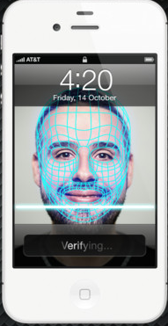



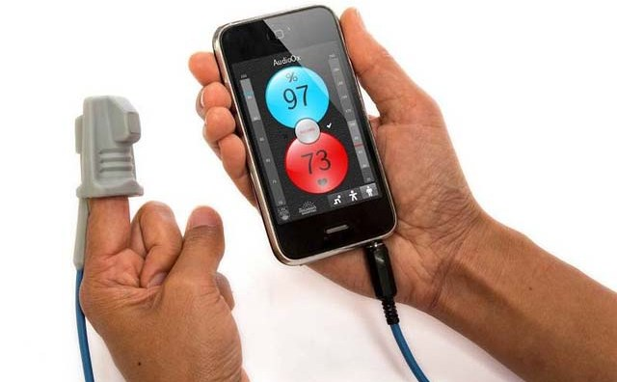
Context
(MCC Applications)
Notes:
Mobile Commerce
Mobile Learning
Mobile Healthcare
Mobile Gaming
A. Mobile Commerce
Mobile commerce (m-commerce) is a business model for commerce using mobile devices. The m-
commerce applications generally fulfill some tasks that require mobility (e.g., mobile transactions and
payments, mobile messaging, and mobile ticketing). The m-commerce applications can be classified into
a few classes including finance, advertising and shopping (Table II).
B. Mobile Learning
Mobile learning (m-learning) is designed based on electronic learning (e-learning) and mobility. How-
ever, traditional m-learning applications have limitations in terms of high cost of devices and network,
low network transmission rate, and limited educational resources [35], [36], [37]. Cloud-based m-learning
applications are introduced to solve these limitations. For example, utilizing a cloud with the large storage
capacity and powerful processing ability, the applications provide learners with much richer services in
terms of data (information) size, faster processing speed, and longer battery life.
C. Mobile Healthcare
The purpose of applying MCC in medical applications is to minimize the limitations of traditional
medical treatment (e.g., small physical storage, security and privacy, and medical errors [42], [43]). Mobile
healthcare (m-healthcare) provides mobile users with convenient helps to access resources (e.g., patient
health records) easily and quickly. Besides, m-healthcare offers hospitals and healthcare organizations a
variety of on-demand services on clouds rather than owning standalone applications on local servers.
D. Mobile Gaming
Mobile game (m-game) is a potential market generating revenues for service providers. M-game can
completely offload game engine requiring large computing resource (e.g., graphic rendering) to the server
in the cloud, and gamers only interact with the screen interface on their devices.

Slide 6
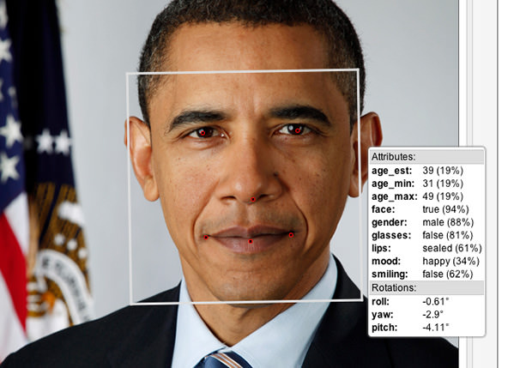
Context
(Computing Vision)

Slide 7
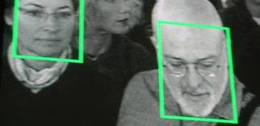
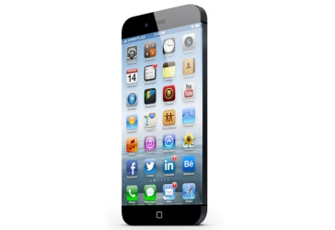
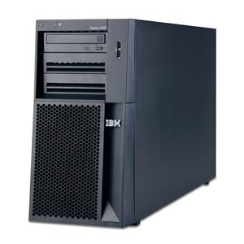


Motivation
Why MCC ?
Why Face Recognition?
Notes:
O dispositivo móvel não tem a capacidade de alto processamento e vai continuar assim por muito tempo pois
As pessoas sempre querem dispositivos mais finos e que consuma menos bateria, então não se pode por exemplo
Simplesmente dobrar a capacidade do processador, pois com isso aumenta-se em 8 vezes o consumo de energia, logo podendo-se investir offloading .
Primeiro é por conta de questões de segurança. Lá fora há o combate ao terrorismo aqui tem por exemplo o vandalismo onde o reconhecimento de delinquentes pode ajudar o combate ao crime.
Segundo

Slide 8
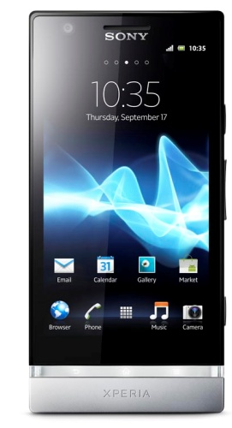

Problem Statement
Terrorists !!!
<Terrorists !!!>
1
They explore Public Clouds.
2
There are metrics and technologies that has not yet been considered on offloading in this context.

Slide 9
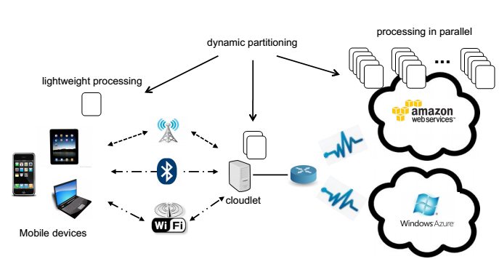
Kickoff
[Public Cloud Vision, 2013]

Slide 10
My Proposal
Mobile Cloud Vision based on Smart Cloud Ranking
It aims to be the first contribution of my PhD.

Slide 11
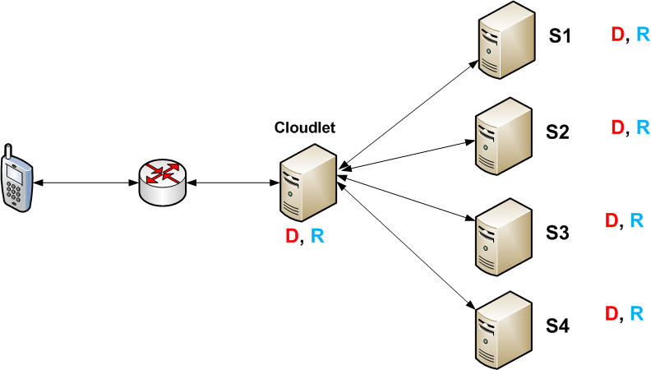

Their proposal
Detection
Recognition

Slide 12
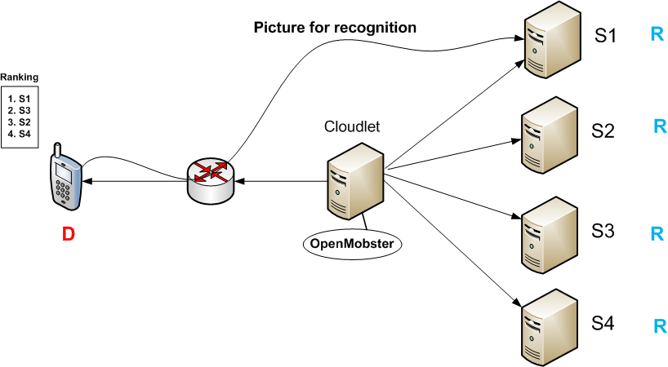

My proposal
Detection
Recognition

Slide 13
My metrics
  Network metrics
    Speed (throughput and delay),
    Accuracy (error rate) and
    Availability
    Electric Power
  Performance
    Time to execute instructions

Slide 14


Experiment Plan
Cloudlet
D, R
Cloudlet
R
D
D, R
R
D, R
R
Their proposal
My proposal
Done!
ANOVA
Number of Faces
Type of Connection
[...]
Round Time Trip

Slide 15
Next Steps
Submission to SBRC 2014
  (deadline: Dec 2, 2013 )
Add new metrics
Use Models ?!

Slide 16

Thank
You!

