Slide 1
Dependability Models for Designing Disaster Tolerant Cloud Computing Systems

Slide 2
Agenda
Motivation
Approach
Architecture
Basic Blocks
Case Studies
Results

Slide 3
Motivation
Why adopt cloud computing?

Slide 4
Why adopt cloud computing?
Cloud computing
infrastructure is available on demand.
Adopted as a service.
Minimizes the costs associated to the IT infrastructure
Service Level Agreement (SLA).
Penalties may be applied if the deﬁned availability level is not satisﬁed

Slide 5
Motivation
Large cloud service providers adopts service level agreements (SLAs) to regulate the availability of the cloud service.
Costs
Availability
Performance (response time)
Service provider needs to carry out availability analysis

Slide 6
Motivation
IaaS – computing resources in the form of virtual machines (VMs).
Disasters
Multiple data located in different geographical locations
Availability improvement
VM migration time increases due to distance between data centers

Slide 7
APPROACH

Slide 8
APPROACH
Evaluate dependability
cloud computing systems deployed into geographically distributed data centers.
(RBD - Reliability Block Diagrams)
(SPN - Stochastic Petri Nets)

Slide 9
ARChitecture

Slide 10
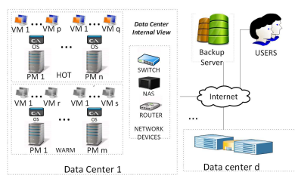
Architecture

Slide 11
(SPN/RBD) BUILDING blocks

Slide 12
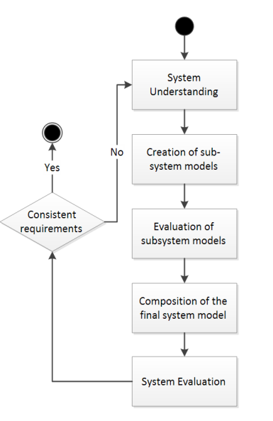
Modeling Approach

Slide 13
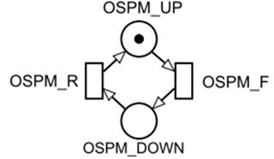
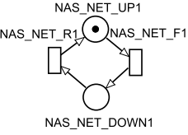
Hierarchical Modelling

Slide 14
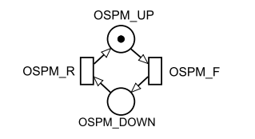
Basic Blocks SPN – Simple Component

Slide 15
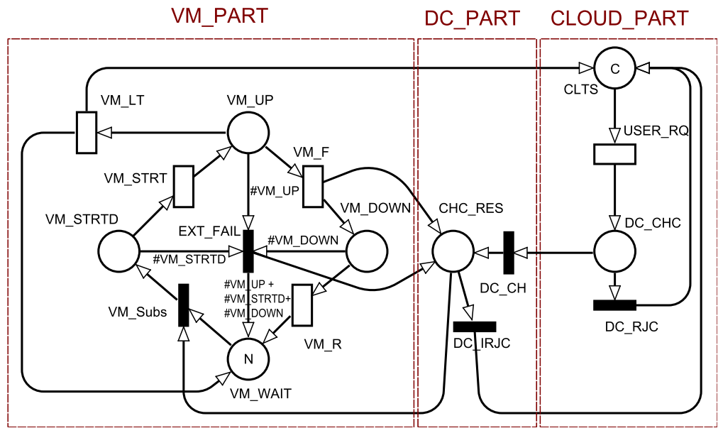
Basic Block – VmBehavior

Slide 16
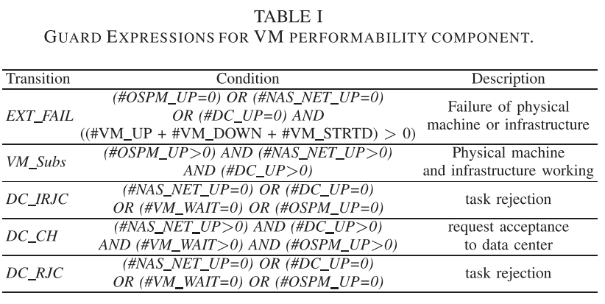
Guard Expressions

Slide 17
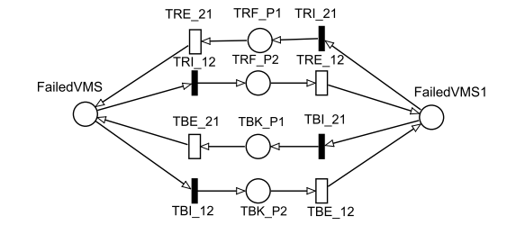
Basic Block – TransmissionComponent

Slide 18
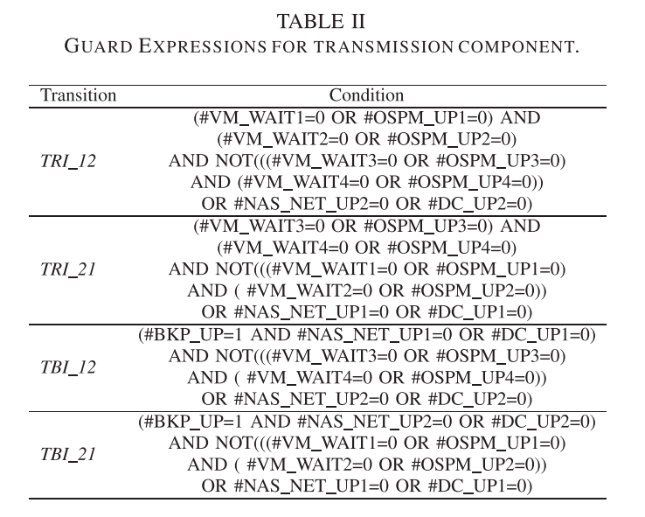
Guard Expressions

Slide 19
Model Composition
Joining building blocks

Slide 20
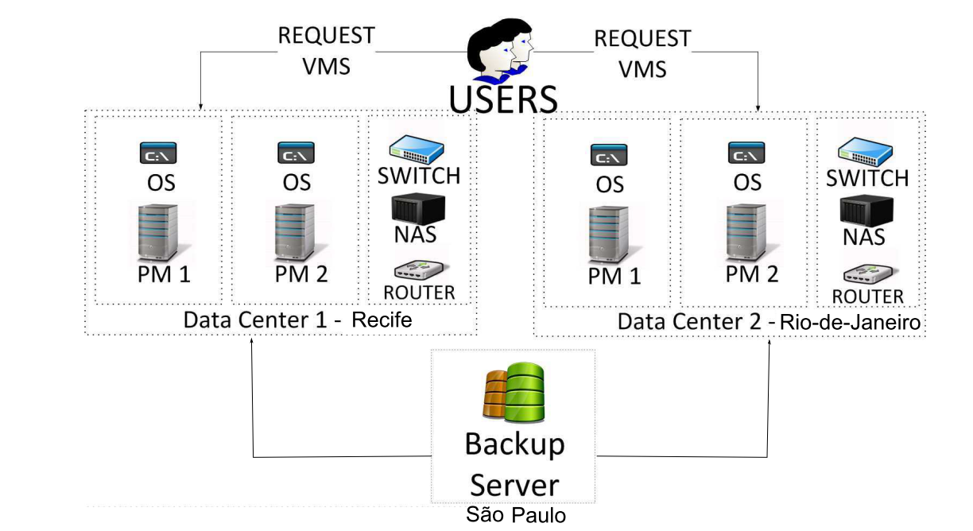
Two Data Centers

Slide 21
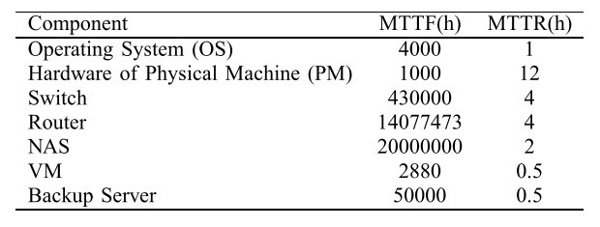
Parameters

Slide 22
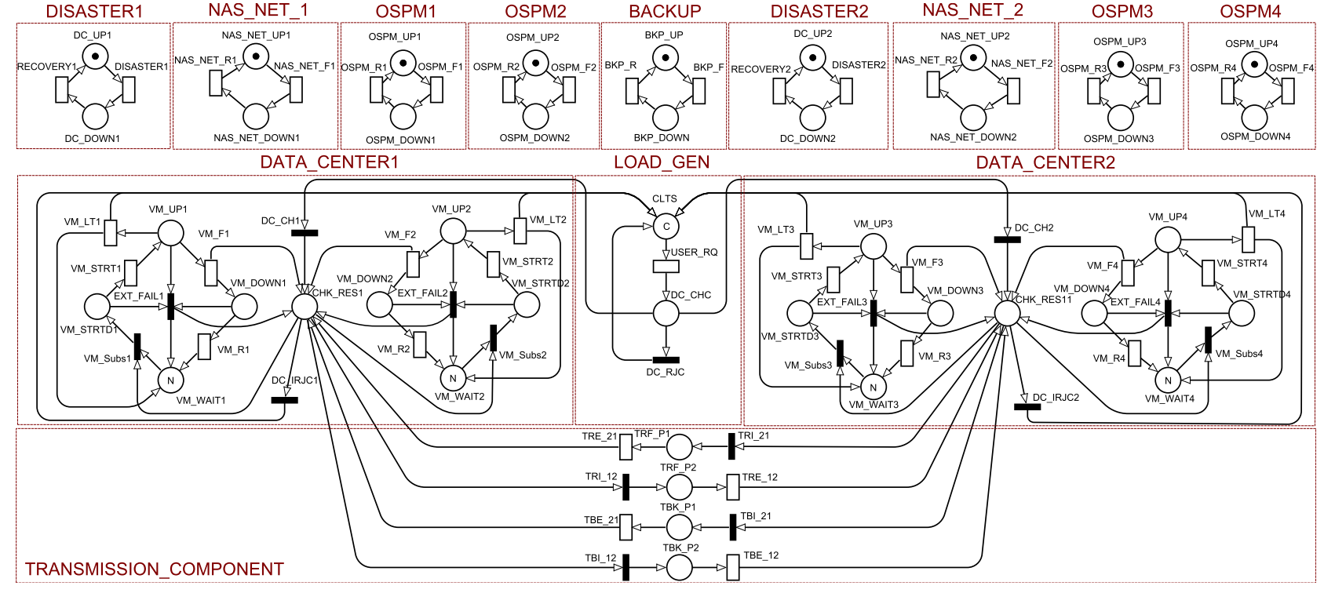
COMBINED MODEL

Slide 23
RESULTS

Slide 24
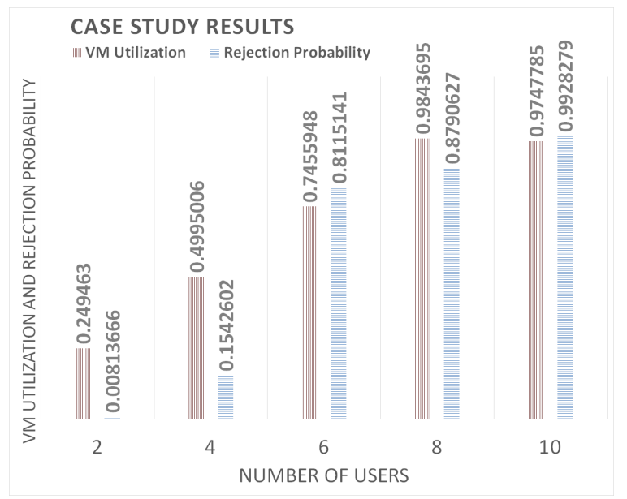
Results
Notes:
Distancias pequenas alto impacto na disponibilidade pela distancia

Slide 25
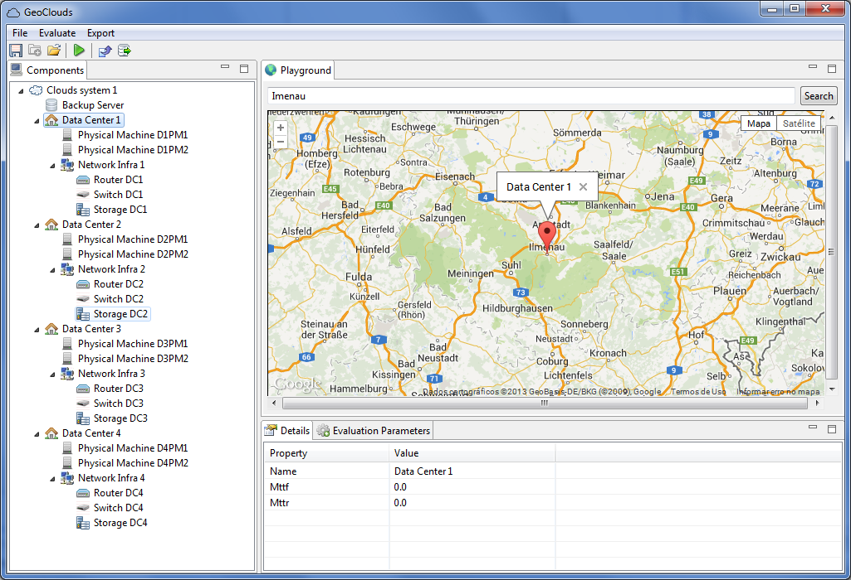
Geoclouds Modcs

Slide 26
Futures Activities
Study the impact of distance and network on disaster recovering.
Finish the tool
Study Survivability Techniques

