Slide 1
Extending the Capacity of Mobile Devices Through Cloud Offloading
Workshop MoDCS 2014.1
Francisco Airton – PhD Student
04 of may, 2014

Slide 2
CONTEXT
Mobile Cloud Computing (MCC)

Slide 3
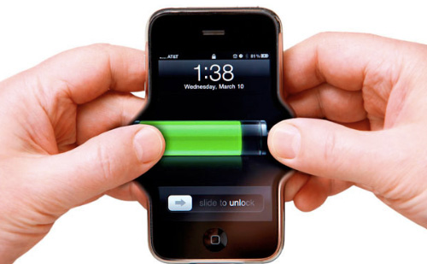
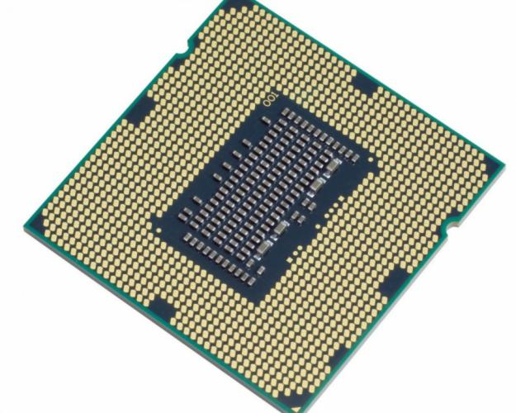
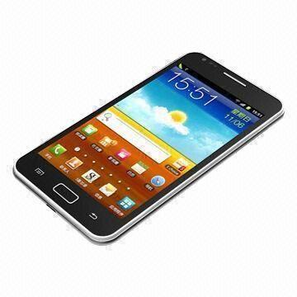
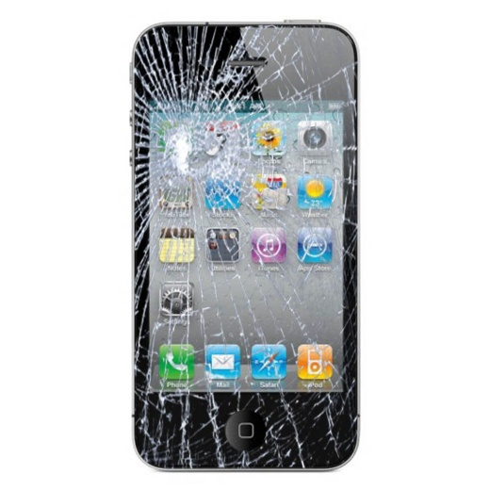
CONTEXT

Slide 4
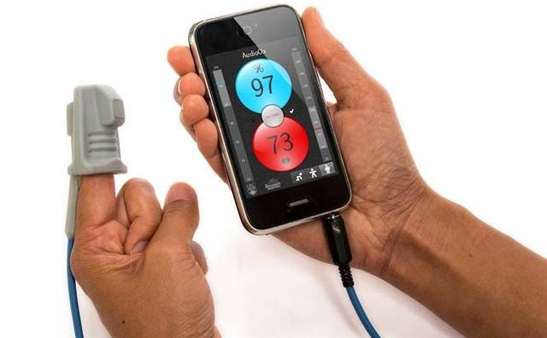
GENERAL PROBLEM STATEMENT
1
3
2

Slide 5
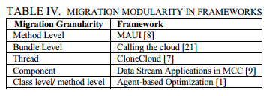
MY SPECIFIC PROBLEM STATEMENT
[JACTAP, 2014]

Slide 6
MY SOLUTION -> Input Level Granularity
App
Method 01
Method 02
Method 03
Input
G = 3
G = Granularity
App
Input 01
Input 02
Method 01
Method 02
Method 03
G = 6

Slide 7
MY SOLUTION -> Input Level Granularity
E.g. Face Recognition
Terrorists !!!
<Terrorists !!!>

Slide 8
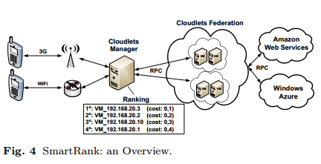
WHAT WE HAVE DONE
1
Mobile Cloud Face Recognition based on Smart Cloud Ranking

Slide 9
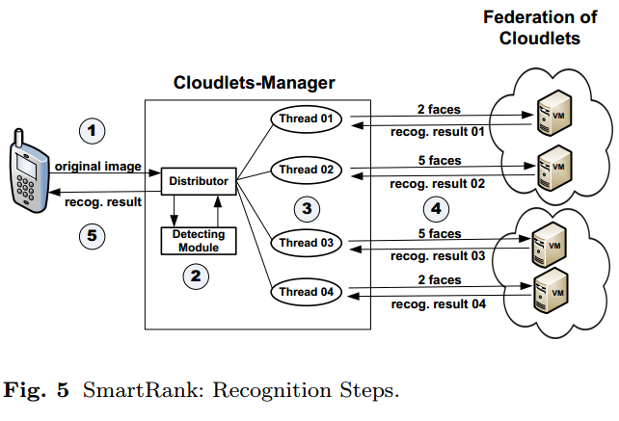
WHAT WE HAVE DONE
1
Mobile Cloud Face Recognition based on Smart Cloud Ranking

Slide 10
WHAT WE HAVE DONE
1
Mobile Cloud Face Recognition based on Smart Cloud Ranking
CPU utilization (U )
Metrics:
Round-Trip Time (RTT )

Slide 11
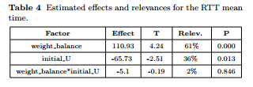
WHAT WE HAVE DONE
1
Mobile Cloud Face Recognition based on Smart Cloud Ranking

Slide 12
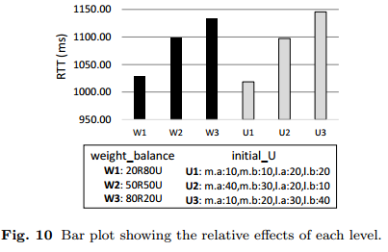
WHAT WE HAVE DONE
1
Mobile Cloud Face Recognition based on Smart Cloud Ranking

Slide 13
WHAT WE HAVE DONE
2
Can Cloudlet Offloading Save Energy for Face Recognition Apps?
How much database load a smartphone support over standalone face recognition process?
Can Offloading Save Energy for Face Recognition Apps?
What is the energy saving obtained by offloading face recognition for cloudlets?

Slide 14
How much database load a smartphone support over standalone face recognition process?

Slide 15
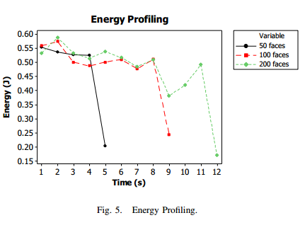

Slide 16
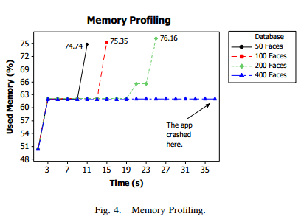

Slide 17
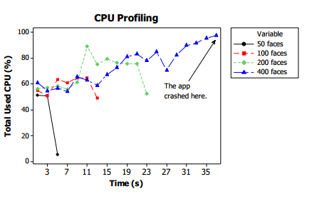

Slide 18
Can Offloading Save Energy for Face Recognition Apps?

Slide 19
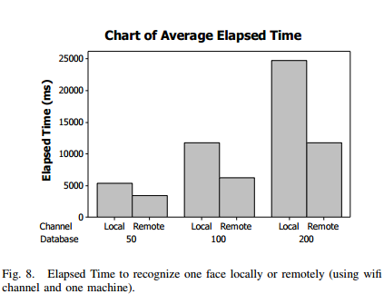
Can Offloading Save Energy for Face Recognition Apps?

Slide 20
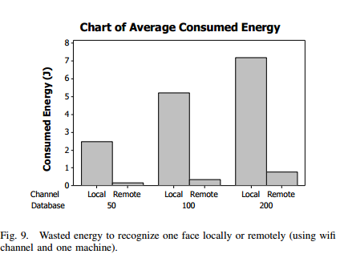
Can Offloading Save Energy for Face Recognition Apps?

Slide 21
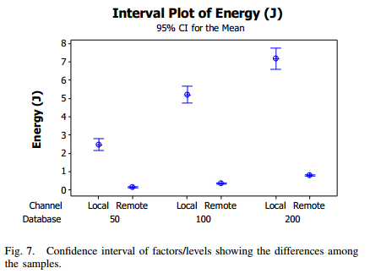
Can Offloading Save Energy for Face Recognition Apps?

Slide 22
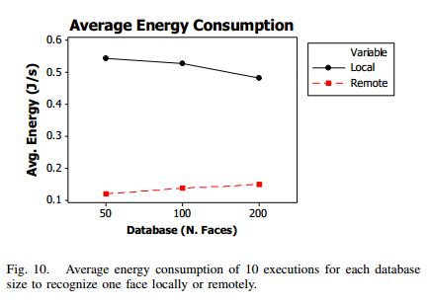
Can Offloading Save Energy for Face Recognition Apps?

Slide 23
WHAT WE ARE DOING
Finishing the paper 02 “Can Cloudlet Offloading Save Energy for Face Recognition Apps?”
Starting a mapping study: “Benchmark Applications used in Mobile Cloud Computing Research: A Systematic Mapping Study”

Slide 24
SOME OTHERS IDEAS TO DEVELOP NEXT
“Eucalyptus Auto-Scaling”
“Compare offloaded itens”

Slide 25
WHAT WE PLAN TO DO IN LONG TERM
Schedule
2015 | 2016
* Generalize SmartRank (+ input gran.) | * Model scenarios for SmartRank
* Use it with the benchmarks reported by the mapping

Slide 26
Thank
You!

