Slide 1
Availability Modeling and Analysis of a VoD Service for Eucalyptus Platform
WMoDCS 2014.1 – Recife, 05 May, 2014.
Maria Clara dos Santos Bezerra | mcsb@cin.ufpe.br
Prof. Paulo Romero Martins Maciel | prmm@cin.ufpe.br

Slide 2
Script
• Introduction
• Sections
• Case Study I
Non-reduncancy architecture
• Case Study II
Redundant architecture
• Case Study III
Future Works
• Results
Maria Clara – WMoDCS – May/2014.

Slide 3
Introduction
}
+ 45 Mi/world
}
+ 1 Bi/months
}
+ 1 Bi/month
}
+ 6 Bi hours/month
YouTube, NetFlix (2014)
Maria Clara – WMoDCS – May/2014.

Slide 4
Introduction
Maria Clara – WMoDCS – May/2014.

Slide 5
Introduction
www.cloudflix.cin.br
Maria Clara – WMoDCS – May/2014.

Slide 6
Sections
Case Study - I
Case Study - II
Case Study - III
Definition of the baseline;
Modeling;
Reach values of dependability;
Model Validation.
Maria Clara – WMoDCS – May/2014.

Slide 7
Sections
Case Study - I
Case Study - II
Case Study - III
Sensitivity analysis;
Redundant architecture;
Recalculate dependability results.
Maria Clara – WMoDCS – May/2014.

Slide 8
Sections
Case Study - I
Case Study - II
Case Study - III
Future Works.
Maria Clara – WMoDCS – May/2014.

Slide 9
Case Study I
Baseline
Maria Clara – WMoDCS – May/2014.

Slide 10
Case Study I
Modeling
Kim, Machida, Trivedi/2003
Maria Clara – WMoDCS – May/2014.

Slide 11
Case Study I
Modeling
Kim, Machida, Trivedi/2003
Maria Clara – WMoDCS – May/2014.

Slide 12
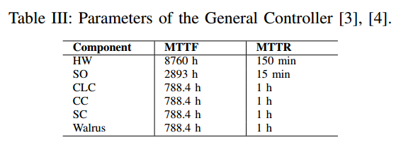
Case Study I
Modeling
Kim, Machida, Trivedi/2003
Maria Clara – WMoDCS – May/2014.

Slide 13
Case Study I
Modeling
Kim, Machida, Trivedi/2003
Maria Clara – WMoDCS – May/2014.

Slide 14
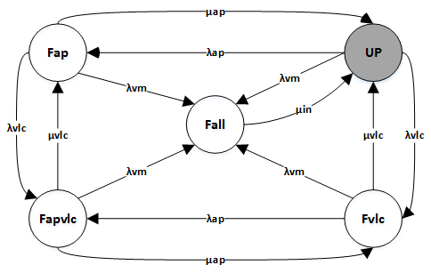
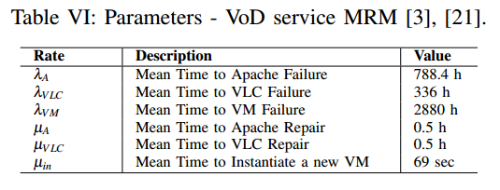
Case Study I
Modeling
Kim, Machida, Trivedi/2003
Maria Clara – WMoDCS – May/2014.

Slide 15
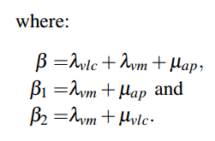
Case Study I
Closed-form
Maria Clara – WMoDCS – May/2014.

Slide 16
Case Study I
Dependability Values
Steady-state Availability: 0.988571
Number of 9’s: 1.94
Availability
Annual Downtime: 100.1 h
Downtime
Maria Clara – WMoDCS – May/2014.

Slide 17
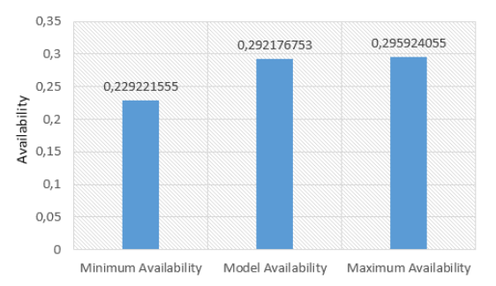
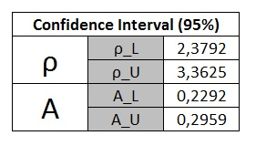
Case Study I
Model Validation
Model Validation
Maria Clara – WMoDCS – May/2014.

Slide 18
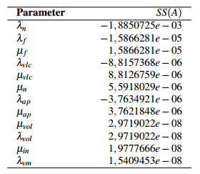
Case Study II
Sensitivity Analysis
Maria Clara – WMoDCS – May/2014.

Slide 19
Case Study II
Maria Clara – WMoDCS – May/2014.

Slide 20
Case Study II
Modeling
Maria Clara – WMoDCS – May/2014.

Slide 21
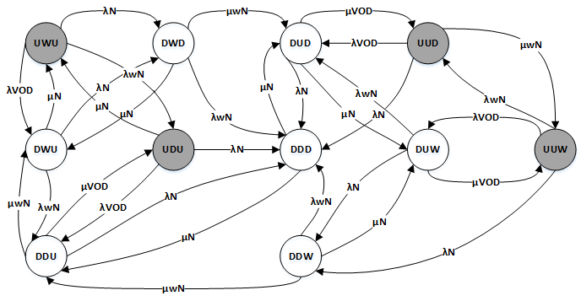
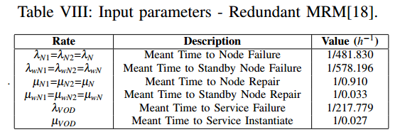
Case Study II
Maria Clara – WMoDCS – May/2014.

Slide 22
Results
Comparison
Non-redundancy
Redundant
Steady-state Availability: 0.988571
Number of 9’s: 1.94
Steady-state Availability: 0.994401
Number of 9’s: 2.25
Availability
Annual Downtime: 100.1 h
Annual Downtime: 49.04 h
Downtime
Maria Clara – WMoDCS – May/2014.
Maria Clara – WMoDCS – May/2014.

Slide 23
Case Study III
Future Works:
• SLA;
• Custos;
• Livre Migration.
Maria Clara – WMoDCS – May/2014.

Slide 24
Bibliografy
Maria Clara – WMoDCS – May/2014.

Slide 25
Questions?
WMoDCS 2014.1 – Recife, 05 May, 2014.
Maria Clara dos Santos Bezerra | mcsb@cin.ufpe.br
Orientador: Prof. Paulo Romero Martins Maciel | prmm@cin.ufpe.br

