Slide 1
REFlex
Renata Medeiros de Carvalho (rwm@cin.ufpe.br)
Ricardo Massa (rmfl@cin.ufpe.br)

Slide 2


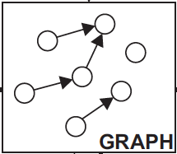
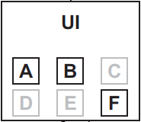
ReFlex
Business Process
Rules
Compiler
Engine
Notes:
The rule engine is divided into 2 modules:
Modeling one: where the business process is compiled into a graph. Each node is an activity and each edge is one kind of behavior (according to the defined rules). There are 7 different edges possible to be defined. The compiler also has a model checking and an inference mechanisms, to avoid contradictory rules and to inference some rules not defined but that does not change the execution.
Execution one: where the user interface shows to the user which activities are enabled at that point and the user chooses an activity. The engine updates the graph according to the executed activity and updates status of the UI.

Slide 3
ReFlex
Business Process
Rules
Compiler
Engine
Notes:
The rule engine is divided into 2 modules:
Modeling one: where the business process is compiled into a graph. Each node is an activity and each edge is one kind of behavior (according to the defined rules). There are 7 different edges possible to be defined. The compiler also has a model checking and an inference mechanisms, to avoid contradictory rules and to inference some rules not defined but that does not change the execution.
Execution one: where the user interface shows to the user which activities are enabled at that point and the user chooses an activity. The engine updates the graph according to the executed activity and updates status of the UI.

Slide 4
ReFlex
Business Process
Rules
Compiler
Engine
Notes:
The rule engine is divided into 2 modules:
Modeling one: where the business process is compiled into a graph. Each node is an activity and each edge is one kind of behavior (according to the defined rules). There are 7 different edges possible to be defined. The compiler also has a model checking and an inference mechanisms, to avoid contradictory rules and to inference some rules not defined but that does not change the execution.
Execution one: where the user interface shows to the user which activities are enabled at that point and the user chooses an activity. The engine updates the graph according to the executed activity and updates status of the UI.

Slide 5
Activities
State
Additional property
Activity
A
Activity
A
Activity
A
enabled disabled blocked
Activity
A
Activity
A
enabled/obliged disabled/obliged

Slide 6
REFlex Rules
General properties
  Source and target
Temporary existence
Weight

Slide 7
State: enabled
Obliged: FALSE
State: disabled
Obliged: TRUE
Relationship
X
Activity B
Activity
A
Relationship
Y
Weight: 0
Temporary: FALSE
Weight: 2
Temporary: TRUE

Slide 8
REFlex Rules
At Least
At Most
Obligation
Temporary Obligation
Blocking
Temporary Blocking
Precedent Obliged

Slide 9
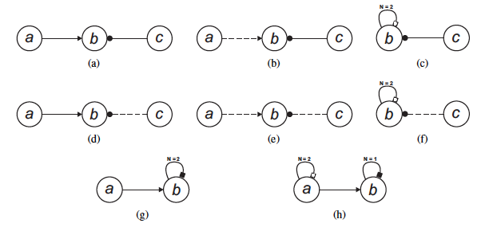
Liveness Enforcing
N = ?
N = ?
N = 1
N = ?
N = 1

Slide 10
Liveness Enforcing

Slide 11
Data-aware Graph
X = 20
User = “adm”
Valid = True
Availability = 0.99
Existence condition
Existence condition
Existence condition
A
B

Slide 12
Alloy
Formal specification language
Alloy Analyzer
  SAT solver
  2 types of analysis
    Search for an instance that satisfies all the constraints and relations specified in a model
    Identification of counterexamples that violates the assertions specified in a model

Slide 13


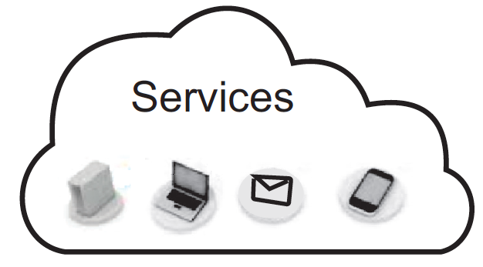
A Declarative Web-Service Orchestrator
Overview
User Interface
Choose activity
A1
A1
A2
A3
A3
A4
A4
A5
An
End
End
Execute activity
Update activities status
Flexible Orchestrator
Rule
Engine
Perform variable bindings
Create SOAP request message
Interacts
with engine
Invoke service
Global variables
response
Update global data
Notes:
Now I will explain how the orchestrator proposed works. The user can see at the User Interface the activities that are enabled to be executed at the moment. So, the user chooses one activity to execute. The orchestrator performs the variable bindings. If there is any local bindings, the UI requests the user for the values. If not, this step is automated. Then, the SOAP request message is created according to the bindings and the service operation is invoked. When It receives the response, the SOAP response message is parsed and the global data is updated with the variable bindings defined. The next step is the interaction with the ruleengine that will be expleined later. The last sept is update the group of enabled activities ans the user can choose another one and continue the process execution.

Slide 14
REFlex

Slide 15
Receive product request
Send product using company shipment
1
Confirm product delivery
3
5
Separate by region
Hire other shipment method
2
4
Penalty charge of shipment company
6
IF cost of 4 ≤
1,25 * cost of 3
IF response time of 5 > x
IF rate of 1 <
10 * rate of 3

Slide 16
Send products by ship
8
Separate products for other countries
7
Send products by airplane
9
IF cost of 9 ≤ 1,5 * cost of 8

